Slide 1
Refined Debt Chasers Objectives
Company reputation
Increase marketing to existing target markets and new target markets
Profit maximization
Debt Chasers to be profitable within 1.5 years
Reduce Costs by 20%
Sales Growth
Expand customer base by 40 in 2 years (by 100 in 5 years)
Increase number of debts serviced for each customer to an average of 40 per year within 2 years
High quality service
High quality of service for our customers (traceability)
Improve customer relations through better quality of service
Efficiency
Process automation/ Increased efficiency in process
Decrease storage space utilization
Employee satisfaction
Notes:
Now that you have clarified the business objectives, knowing the priority of these objectives is essential to producing a plan for a solution that will make the biggest impact for the customer, as early as possible.
It is critical to have a client prioritize objectives at the beginning of a project because at this point there is less emotion attached to the process.
Once a project begins, should the schedule get behind, getting the business to prioritize objectives at that point is more frustrating. The client tends to say "I want it all...." and that's not helpful toward getting a release complete.
If we have prioritized objectives, should things fall behind, we can help the client alter the scope of a release by pointing back to satisfying their highest priority objectives.

Slide 2
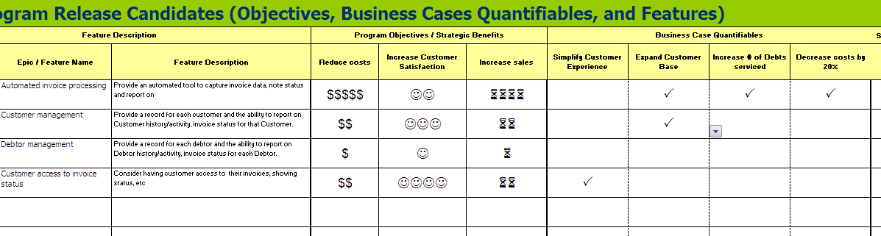
Business Case Quantifiables
Notes:
As you progress through the initiation phase and begin to understand the features that the new application will provide, you can begin to quantify the objectives for the business case.
Use to prioritize requirements
Use to validate objectives

Slide 3
High Level Scope
IS
IS NOT
Create and maintain customers
Create and maintain debtors
Create and maintain invoices
Search for invoices, customers, debtors
Create letters
Letter queue by day
Create envelopes
Reporting
Could be:
E-letters to debtors
Will never be:
UNRESOLVED
Customer access to debts, invoices
Notes:
Using the business objectives and the features noted in your Elevator pitch exercise, determine high level scope.
Work this better!

Slide 4
Elevator pitch
For (target customer)
Who (statement of the need or opportunity)
The (product name) is a (product category)
That (key benefit, compelling reason to buy)
Unlike (primary competitive alternative)
Our product (statement of primary differentiation)
Notes:
High level solution.
Now we know the problem and the causes, and we think we know what will help us out of this, now let’s try to describe what we are going to build.
Techniques for getting here - Product in a box, Affinity diagram of post its.

Slide 5
Trade off Sliders
Scope - coverage of code base and activities
ON
OFF
Stay within budget
ON
OFF
Deliver the project on time
ON
OFF
High quality: Stability, reliability, adaptiveness
ON
OFF
Customer satisfaction or usability
ON
OFF
Notes:
One way to prioritize is with the use of Trade Off Sliders. No two concepts can have the same rating.
Trade-off sliders are a good option to understand what is important to different people in a client organization. If we had infinite time, budget and resources, in an ideal world, trade-off may not be necessary. In reality, a project may have to undergo some trade-off to achieve an optimum level.
If in release planning you discover that there is not enough time allotted for usability testing or that the velocity used to planning does not allow for adequate defect resolution, then you can go to the sliders to determine if there is flexibility in the budget and/or timeline to adjust the velocity or add time/resources for usability testing.
How to get this information?
Sponsor homework.
Small group session. Keep the group small, but well represented – budget, business, IT, users.

Slide 6
Roles and Goals
Who am I?
What do I want to do?
How will you support my goals?
Managing Director
“I’d like to easily see the status of Customers’ invoices”
Provide online information regarding Customers’ accounts.
Administrative Assistant
“ I need to generate a lot more letters than I do today”
Provide an automated approach to letter generation.
Technology Manager
“ I want to easily support all users”
Provide a solution in a language I can support.
Sales
“ I want to be able to sign on more customers with confidence.
Provide a that can accommodate additional customers with the quality service.
Customer
“ I need to be confident that DC knows the status of each of my debtors’ invoices”
Provide a way to reflect invoice status by Debtor.
Notes:
Understand the differences between users of the same role.
Admin asst.
Sales. Manager, Sales folks.
Is Customer a role we should track?

Slide 7

User Scenarios
Use scenarios to inform your thinking and create an end-to-end journey
Consider a persona + a task + an environment
Use scenarios to drive out requirements and to validate that solutions can solve the tasks identified in all possible environments.
“I have 165 invoices to process today, I’d really like to get it done quickly so that I know that I’ll have time to deal with any customer & debtor requests, so that I can deal with them more effectively in a less stressed way.
For each new invoice I need to record the customer details, the debtor details and then I need to type and send the first letter to the debtor.”

Slide 8
Persona
Administrative Assistant: Abigail Goodman
Abigail is 18 years old and has works at DebtChasers as a temporary job for the summer before she goes to university.
Abigail has proved that she can write letters and deal with customers but isn’t really seen as integral to the team.

Slide 9
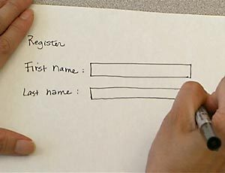
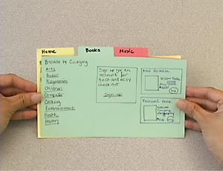
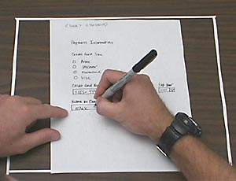
Low-Fi Prototypes
Notes:
Allows teams to test out interfaces without writing code.
Easy and inexpensive modifications
User is involved and comfortable being critical of a paper document vs a coded look
By running the various scenarios through the prototypes, you can find new requirements
Mid fi – Balsamiq
-------------------------------------------------------------------------------------
From an article in Wikipedia, we get:
Paper prototyping saves time and money since it enables developers to test product interfaces (from software and websites to cell phones and microwave ovens) before they write code or begin development. This also allows for easy and inexpensive modification to existing designs which makes this method useful in the early phases of design. Using paper prototyping allows the entire creative team to be involved in the process, which eliminates the chance of someone with key information not be involved in the design process. Another benefit of paper prototyping is that users feel more comfortable being critical of the mock up because it doesn’t have a polished look.
There are different methods of paper prototyping, each of them showing several benefits regarding the communication within the development team and the quality of the product to be developed: In the development team paper prototypes can serve as a visual specification of the graphical user interface, and by this means assure the quality of a software. Prototyping forces a more complete design of the user interface to be captured. In team meetings they provide a communication base between the team members. Testing prototypes at an early stage in development helps to identify software usability problems even before any code is written. The costs and annoyances of later changes are reduced, the support burden is lowered, and the overall quality of the software or website is increased.

Slide 10
Story
Unique #:
Title:
Priority:
I will know this is complete when…….
Description:
As a <Role>
I want to <Goal>
So that <Value>
Assumptions:
Estimate:
Complexity:
Completeness:
Volatility:
Notes:
You’ll see there is a fair amount of information to capture for a story.
Both front
[CLICK]
And back of the card. If you’re using index cards.
We’ll talk about each of these now.
You may hear the acronym RAIDs
Risk
Assumptions
Issues
Dependencies

Slide 11
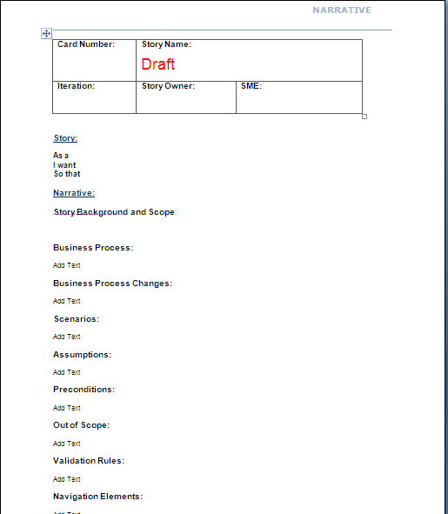
Narrative
Header
Purpose / Background / Context
Dependencies
Scope Exclusions
Business Rules
Screen Shots
RAID
Other
Acceptance Criteria
Notes:
Create a template to define the sections that are necessary for your project.
Header
Card #, Name, Iteration, Functional Area, Functional Lead, SMEs
Purpose /Background / Context
In a short paragraph or two the overview or summary section should introduce the reader what this narrative is about (story), why is this being done, and the business value it will generate.
Should tell the reader of where and how the functionality will fit in the overall picture and how it will change/enhance the existing system or add/expand the functionality of the proposed system.
Dependencies
It should also highlight the dependencies this feature has and what other features/functionality is related to this. The intention of dependencies and related features is to give the developer some clues upfront to prioritize their tasks and to direct them in the direction of existing functionality that is similar and may already be out there.
Scope Exclusions
This section should note any known scope areas that are not included in the story card.
Business Rules
Define any validations or exceptions handling that should occur
Screen Shots
Put screen shots here if editing or adding screens / fields
Risks, Assumptions, Issues, Dependencies
Used to set context of decisions made, approach taken or scope
Other details
Interface considerations
Security
Performance and other non functional considerations
Acceptance Criteria
End to end tests of the functionality. Should be how the customer would actually use the system in real life.
List the customer name(s) related to the story here. For questions / clarifications

Slide 12
Iteration Level Acceptance Criteria
GIVEN
(State of the system/ Role performing the action)
WHEN
(Action that is going to be performed)
THEN
(What is expected to happen)

Slide 13
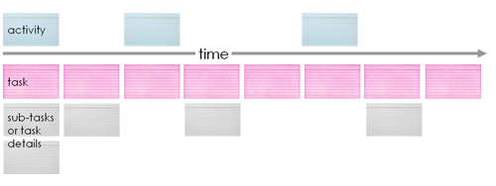
Story Map
a.k.a. Walking Skeleton, Hudson River Company Start, or Tracer Bullet
Diagram from Jeff Patton’s blog
http://www.agileproductdesign.com/blog/the_new_backlog.html
Notes:
A Master Story List is helpful for a number of things, but it does not easily represent what is being built.
Story Mapping is an approach that intersects with Vertical Slicing, and adds a focus on creating value to address a specific business need - according to Jeff Patton, “a minimum viable product - an MVP.” Jeff’s example is building a car – you can’t do anything with it if it has an engine without a transmission or brakes or suspension.
In Story Mapping, we look for the set of stories (features, user tasks, user stories) that create some specific functionality such that the system can be used. These are “horizontal” in that we don’t care about the system’s layers, but rather care about having all the pieces we need to be able to do something. In fact, we pretty much ignore the layers we considered in Vertical Slices, at least from the standpoint of planning.

Slide 14
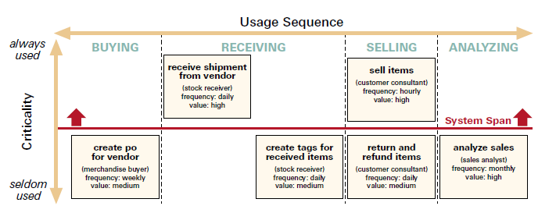
Span Plan
http://www.agileproductdesign.com/writing/how_you_slice_it.pdf
Notes:
Jeff Patton
Lay out the stories horizontally in process sequence as we did in Story Mapping
Place them vertically by criticality. Always used vs seldom used. Another way to assign Priority!
Slice them horizontally by release
Goal is to get a full path through the system in a release.
Break down by
Product line
Customer base
Transaction type
Small example vs 300 – 400 stories.
Do a pre-grouping first of high level functional areas or flavors or variations
Need lots of space
Patton, Poppendicks
Usage/sequence diagram
Cut by role
Cut by span – release. The minimum amount of features to be usable to the business.
1st release may not support all roles.
1st release may not be a public release.
Testers can evaluating the flow of the system.
Techs can start evaluating the architecture and scalability of the system

